Slide 2
Using LTPP Data in Evaluating the Effectiveness of Pavement Smoothness

Slide 3
Using LTPP Data in Evaluating the Effectiveness of Pavement Smoothness
International Roughness Index (IRI)
“The IRI can be defined as: the simulation of the roughness response of a car traveling at 80 km/hr. It is the Reference Average Rectified Slope, which expresses a ratio of the accumulated suspension motion of a vehicle, divided by the distance traveled during the test” [1].

Slide 4
Using LTPP Data in Evaluating the Effectiveness of Pavement Smoothness
International Roughness Index (IRI)
Smoothness specifications are in place to ensure quality roads are being built.
Monetary incentives/disincentive policies based on initial roughness encourage contractors to build smoother roads.
Due to the extra costs, it’s important to prove that smoother roadways stay smoother over time.

Slide 5
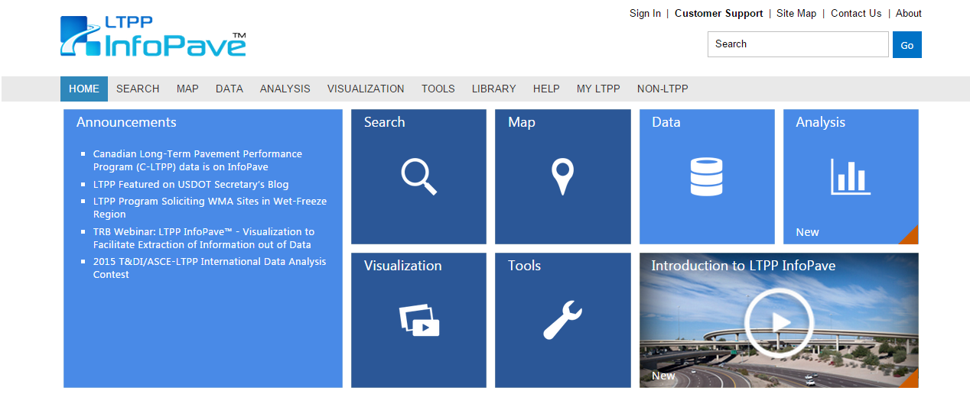
IRI: Step 1...
www.InfoPave.com
Register or Sign in.

Slide 6
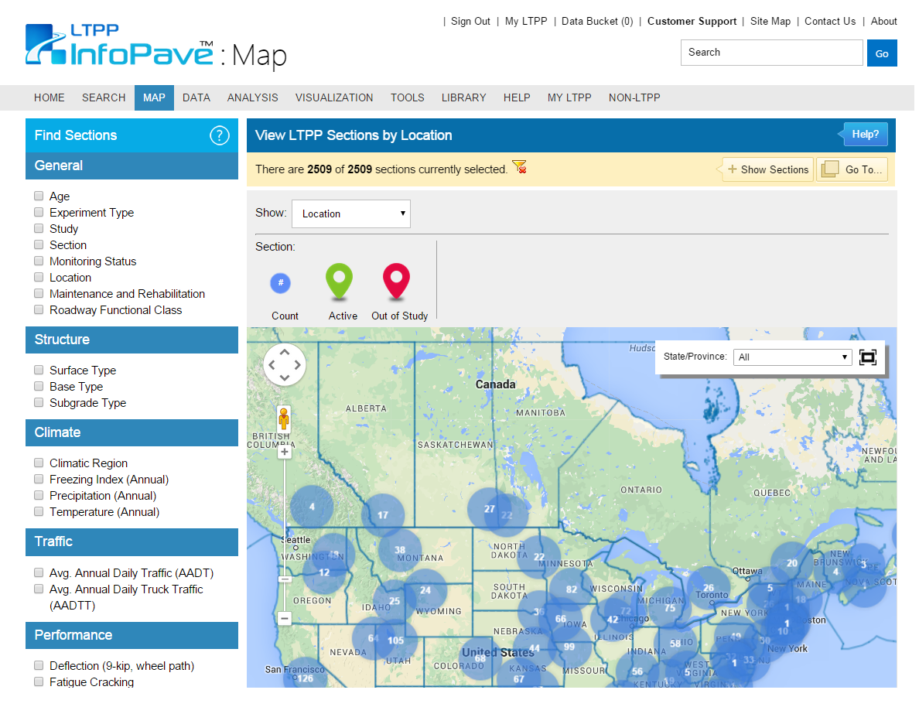
IRI: Step 1...
www.InfoPave.com/Map/ByLocation/
Locate which sections pertain to your study.
Use filters to narrow search parameters.

Slide 7
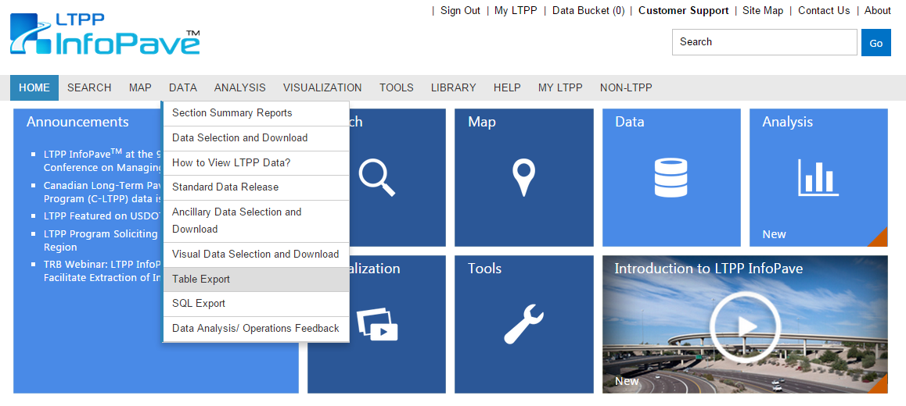
IRI: Step 2
www.InfoPave.com/Data/
Go to: Data, click “Table Export”

Slide 8
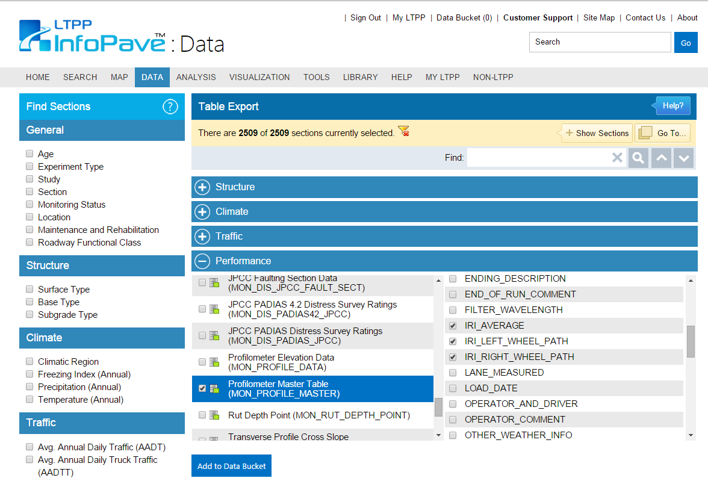
IRI: Step 2...
http://www.infopave.com/Data/TableExport/
Expand “Performance” tab and select “Profilometer Master Table” and IRI data required.
Click “Add to Data Bucket”

Slide 9
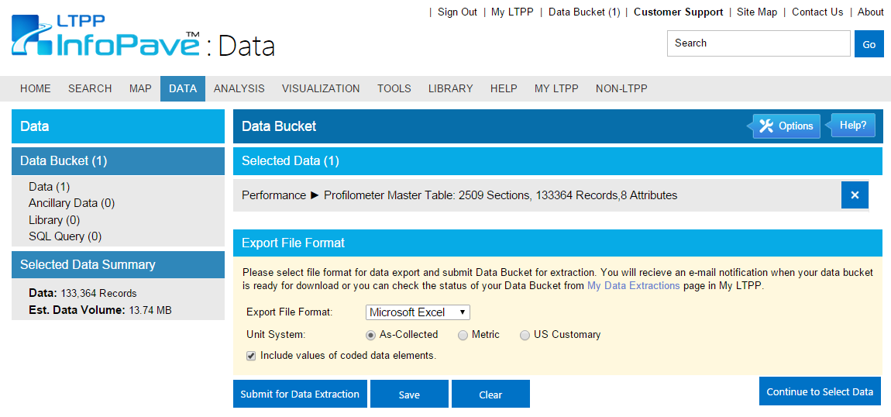
IRI: Step 3
http://www.infopave.com/Data/TableExport/
Select preferred export format.
Click “Submit for Data Extraction”

Slide 10
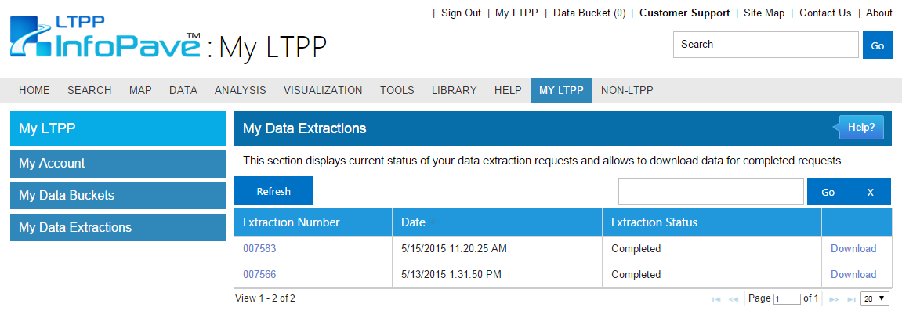
IRI: Step 4…
www.InfoPave.com/MyLTPP/MyDataExtraction
Go to: My LTPP
Go to: My Data Extractions
Download & Compile given data.

Slide 11
IRI: Step 5
The IRI is directly related to the pavement condition, which is based on a Pavement Serviceability Rating (PSR) system.
This PSR system runs on a scale of 0.0 to 5.0
“Factors considered in determining the PSR for a given section of roadway are ride quality in terms of the IRI, average rut depth and age of the surface course. IRI values and average rut depth are taken directly from profiler data.”[1]

Slide 12
IRI: Step 5
Figure 2.2 shows data from the International Road Roughness Experiment relating the Pavement Serviceability Index (PSI) to IRI. [1]
As serviceability ratings are dominated by vehicle ride perception, a close correlation with IRI roughness is expected. [1]

Slide 13
Questions?

Slide 14
References
Dr. Khaled Ksaibati and Shahriar Al Mahmood. Utilizing the Long-Term Pavement Performance Database in Evaluating the Effectiveness of Pavement Smoothness. Department of Civil and Architectural Engineering, The University of Wyoming, Laramie, Wyoming, March 2002
Long Term Pavement Performance. LTPP InfoPave. www.infopave.com.

